Slide 1
Unlocking AI Superpowers: Steps to Succeed with AI in a Health System
July 2024

Slide 2
How to Leverage AI as a Superpower
How can we use AI to give healthcare providers and administrators superpowers in serving their patients and communities? We are bombarded with breathless enthusiasm and often feel we are missing out or are ignorant where others are wise.
Learning Objectives:
What is the current practice and sentiment within leading edge healthcare organizations?
What are the most common necessities left off the AI checklist?
What tools, processes, and types of people do you need in place to scale?

Slide 3
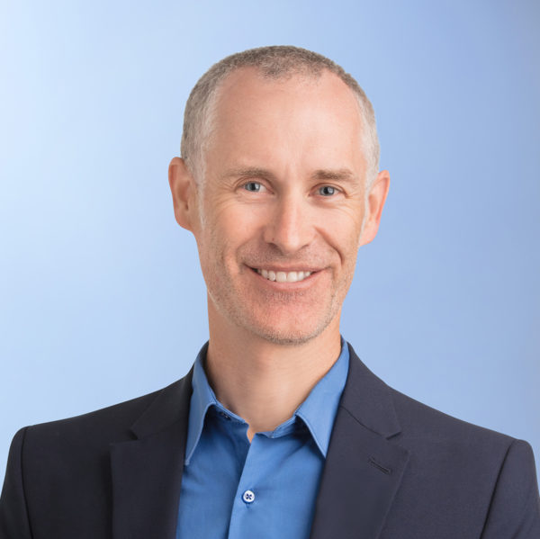
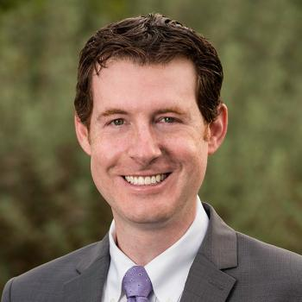
Today’s Speakers
Jason Jones, PhD
Chief Analytics & Data Science Officer, Health Catalyst
Michael Pfeffer, MD, FACP
Chief Information and Digital Officer and Associate Dean, Stanford Health Care and Stanford University School of Medicine

Slide 4
What is the current practice and sentiment within leading edge healthcare organizations?
Notes:
[

Slide 5
What are the most common necessities left off the AI checklist?

Slide 6
What is Needed to Sustain, Spread, and Scale?

Slide 7
Resources and Referenced Materials
Stanford Article: The Next 5 Years of AI in Healthcare
Health Catalyst Article: The Rise of Augmented Intelligence: Insights for Healthcare Leaders
JAMA Network Article: Artificial Intelligence–Generated Draft Replies to Patient Inbox Messages
JAMA Network Article: Creation and Adoption of Large Language Models in Medicine
Healthcare AI Checklist and Framework: Standing on FURM ground

